Slide 1
Intro to Tekton

Slide 2
Mission

Slide 3
Industry-standard, cloud-native CI/CD platform components and ecosystem.

Slide 4
What is “cloud native”?

Slide 5
Cloud Native Computing Foundation (CNCF)
}
Microservices in containers
Images / Containers
}
Dynamically orchestrated
Optimized resource utilization
(Often) Kubernetes
Notes:
If you ask 5 different people to define cloud native, they’re all going to say different things, but here’s a breakdown of the Cloud Native Computing Foundation’s definition.
And what this often boils down to, is that this means running containers on Kubernetes.
This isn’t always the case, there are other ways to be cloud native, but this the context I’ll be assuming for this talk.
You package your software in images, and kubernetes manages the execution of those images as containers.

Slide 6
For who(m)?

Slide 7
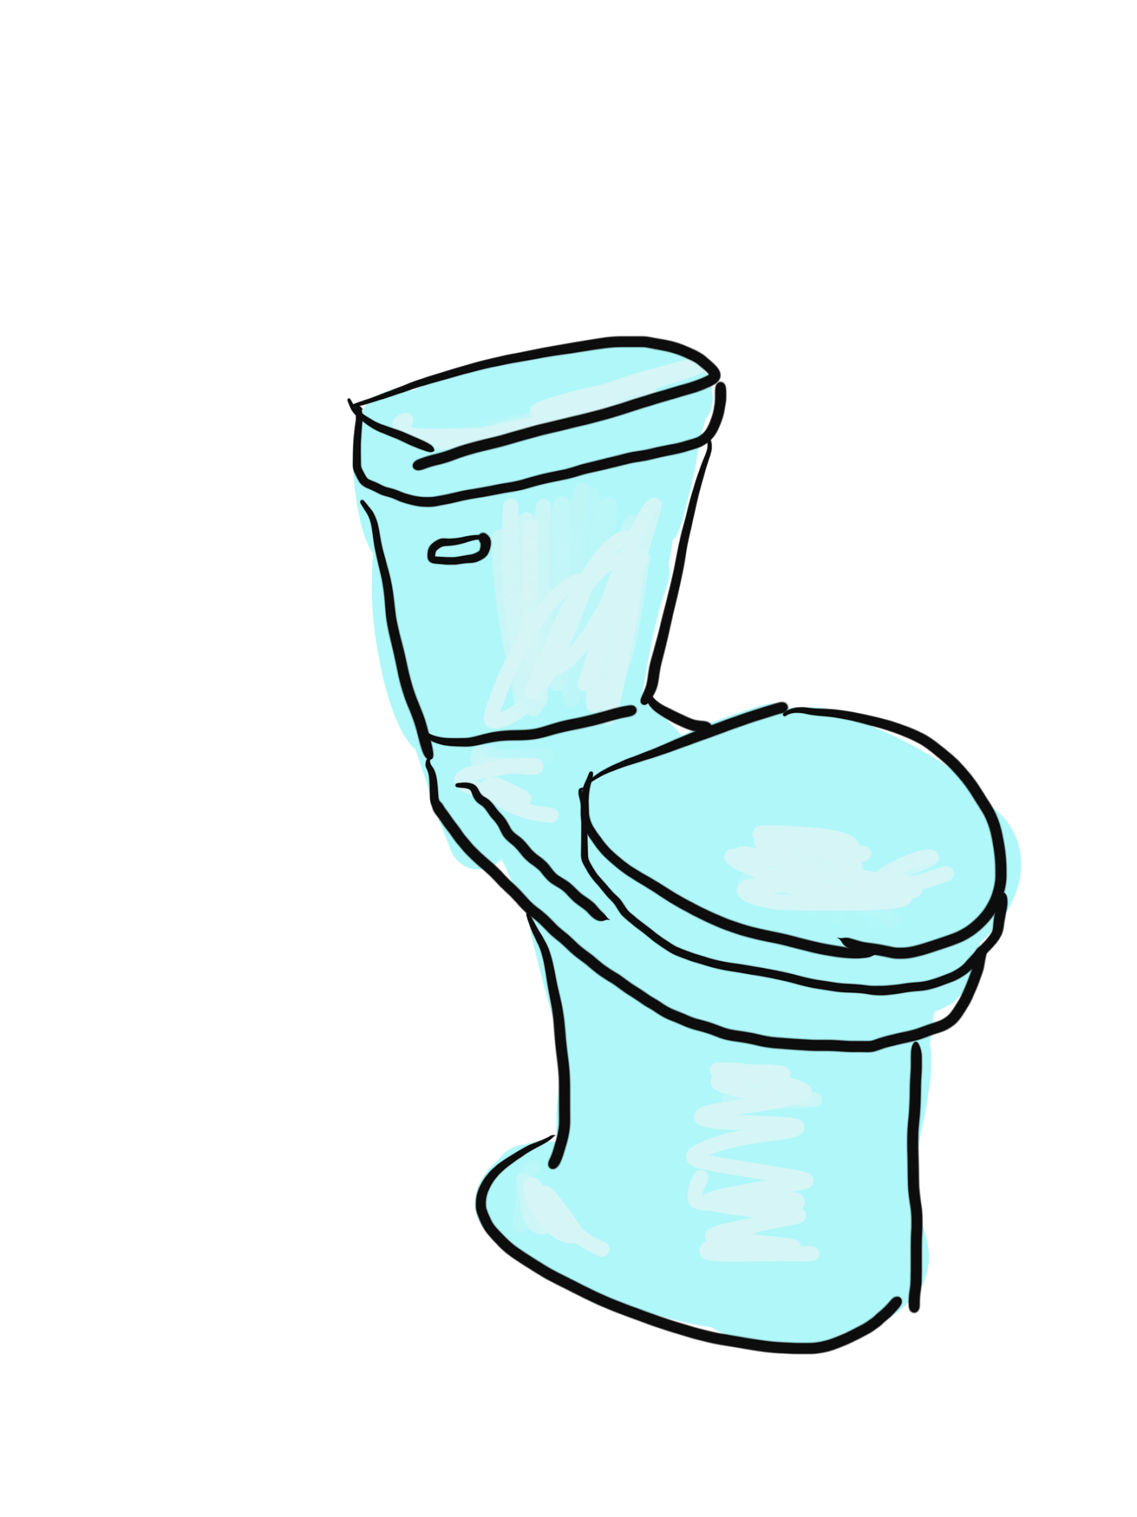
Porcelain vs Plumbing
Toilet vs. Plumbing Underneath
Notes:
So what is Tekton?
Who here has heard the analogy “porcelain vs plumbing”?
So the idea is, that if you were looking for a toilet, and you found just the plumbing underneath it, you’d be pretty disappointed.
You need the porcelain in order to have a good user experience, but you need the plumbing in order for the thing to actually work.
So in this case Tekton is the plumbing, not the porcelain.

Slide 8
For who(m)?
Engineers building CI/CD systems
Stop reinventing the wheel!
Scalable
Serverless
Cloud Native
Engineers using CI/CD (everyone)
Catalog of reusable components
Quick assembly
Tekton conformant systems
Interoperability
Portability (no lock-in)
Ecosystem of tools

Slide 9
Tekton Pipelines

Slide 10
Existing Industry standard:
Container images
Image

Slide 11
Steps:
Kubernetes container spec, adds stuff like:
Environment vars
Arguments
Step
Image

Slide 12
Task
Task, adds:
Steps in order
Params
Workspaces
Results
Step
Image
Step
Image

Slide 13
Pipeline
Pipeline, adds:
Graph
Inputs + outputs:
Workspaces
Results -> Params
Conditions
On Failure
Task
Task
Task

Slide 14
Tekton Triggers

Slide 15
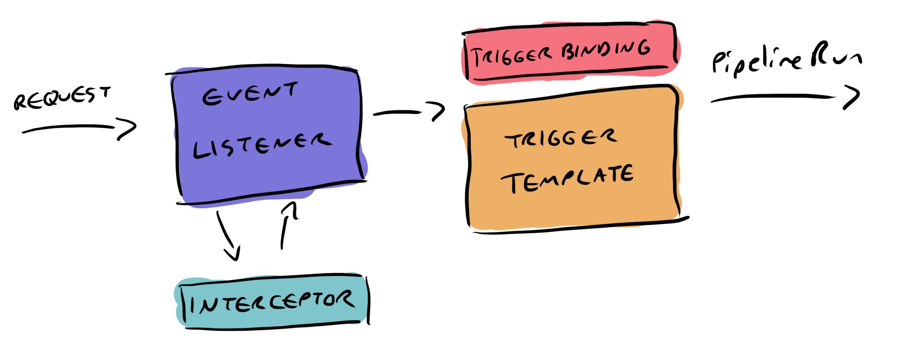
Tekton Triggers Types

Slide 16
Tekton Catalog

Slide 17
Tekton Catalog
Images
Tasks
Pipelines
Conditions
TriggerBindings
TriggerTemplates
Trigger interceptors
Sandbox + Official
Well tested
Well documented
Supporting the catalog = Tekton conformance
Versioning + referring to Tasks:
taskRef ->
OCI artifact
Git repo
Anything really

